Slide 1

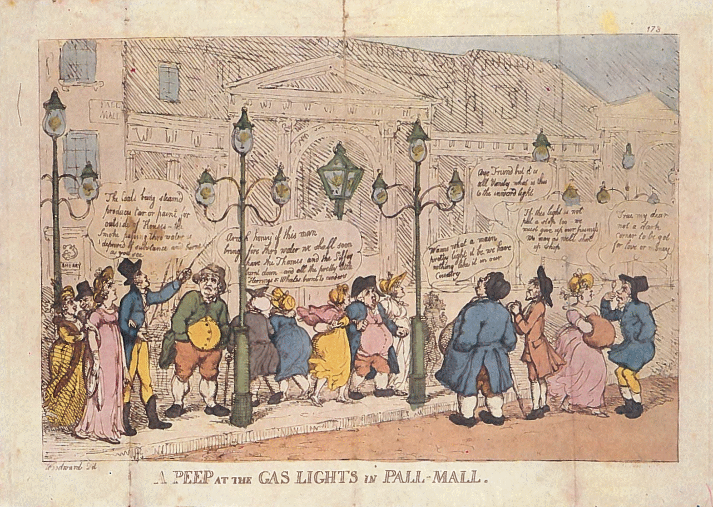
The hydrogen economy
Paul Dodds
University College London
23 February 2021

Slide 2

Frederick Winsor.
Chantler & Lacey (1949)
Notes:
Originally Friedrich Albrecht Winzer
A green plaque on Pall Mall in London marks the site of Winsor's first demonstration, and there is a memorial to him in Kensal Green Cemetery. Winsor Terrace in Beckton, the former approach road to Beckton Gas Works, is named in his honour.

Slide 3

1812: hydrogen becomes mainstream as the Gas Light and Coke Company is incorporated to provide lighting
Why town gas?
Economic case: cheaper than whale oil.
Quality of service: brighter, safer flame.
Widespread adoption for street lighting by 1820.
Also used for cooking from 1875.
William Murdock.
Chantler & Lacey (1949)

Slide 4
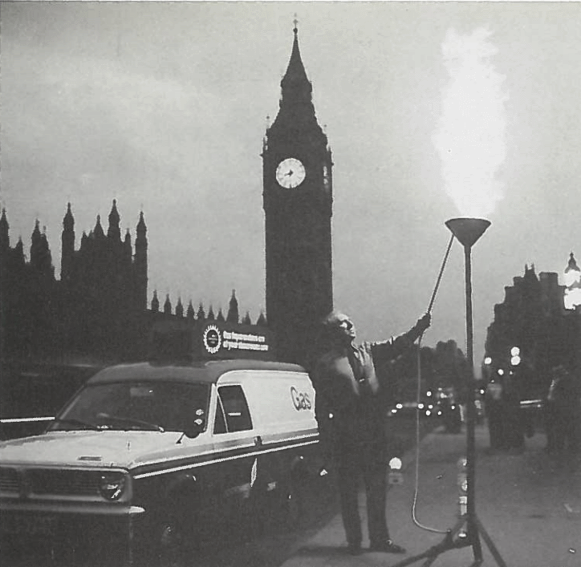
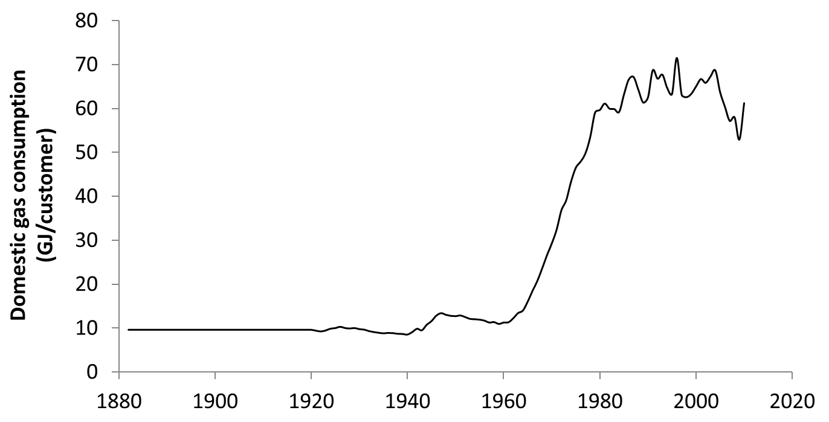
Rise of natural gas
Natural gas discovered in the North Sea in 1959.
Conversion programme starts in 1967 and is completed in 1977.
Heating becomes the primary market.

Slide 5
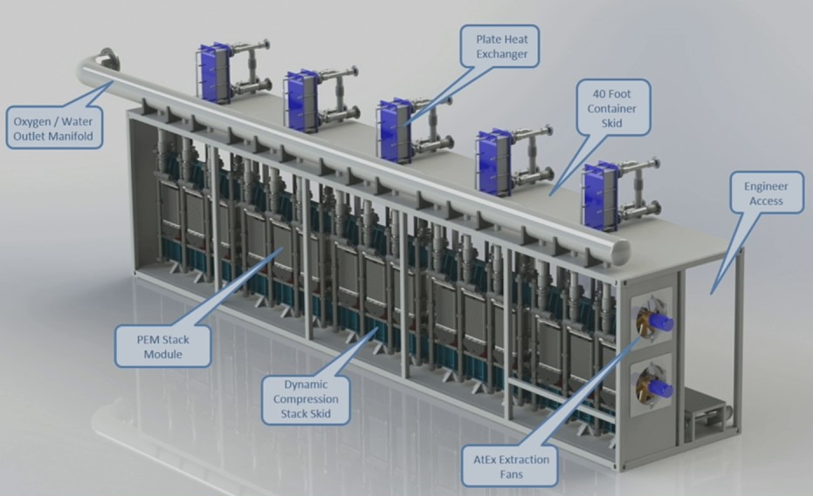


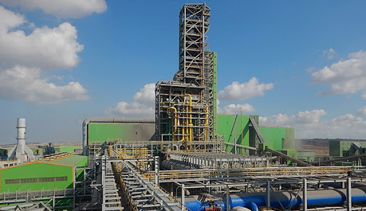
Will we return to using hydrogen in the future?

Slide 6


History of hydrogen in transport

Slide 7
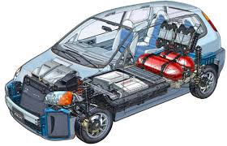
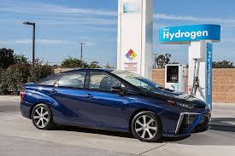
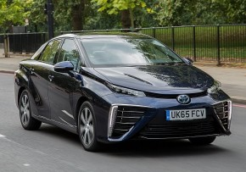
The future: fuel cell cars powered by hydrogen?
Hyundai ix35: 101 kW
Toyota Mirai: 113 kW
Notes:
Fuel cell cars are being commercialised

Slide 8
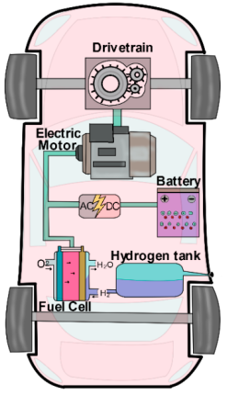
Do fuel cell vehicles work? How are they designed? Are they safe?
Cars have a fuel tank, fuel cell and electric motor.
All commercial vehicles are hybrids, with battery packs of various sizes.
PEM fuel cells operate at around 90 ºC – so water drips out of the exhaust.
Fuel cells are uniquely scalable, with even small cells having high efficiency.

Slide 9
David Cebon, professor of mechanical engineering at Cambridge University…
“Energy conversion processes required by the green hydrogen economy (electrolysis, compression, storage and fuel cells) are very inefficient: wasting energy as low grade heat. A huge amount of new renewable electricity capacity would be needed to compensate for the wasted energy.”
“The proposed green hydrogen economy is unlikely to be realisable in the UK because of sheer amount of renewable electricity required, the low Technology Readiness Level (TRL) of large scale electrolysis and the undeveloped technology for storing hydrogen in salt caverns.”
https://greenallianceblog.org.uk/2021/02/11/pursuing-the-hydrogen-economy-as-a-climate-solution-will-be-a-big-mistake/
Notes:
Truths and half-truths, leading to a conspiracy theory: it’s a fossil fuel industry con (which is partly correct – the fossil fuel industry is pushing it, but that doesn’t mean it is a bad option).

Slide 10
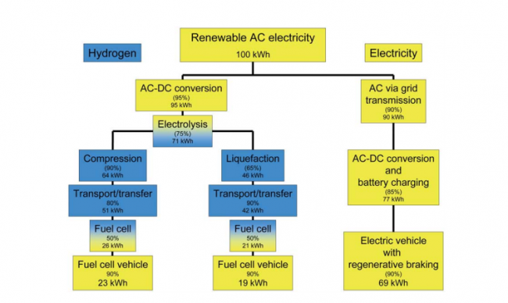
Useful transport energy derived from renewable energy
Ulf Bossel (2006) Does a hydrogen economy make sense? IEEE

Slide 11
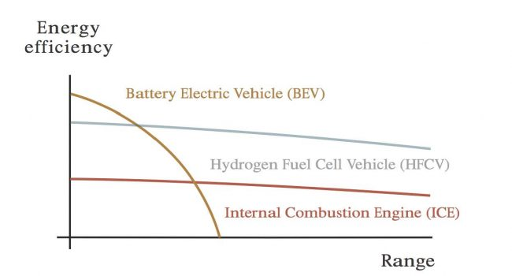
Markets for different types of vehicle
Batteries have much higher powertrain efficiencies
But what is the range of a battery electric vehicle?
  Vehicle efficiency (kWh/km) is quite different to powertrain efficiency.
  Vehicle efficiency depends on the weight of the car.
  Battery vehicles become increasingly heavier as the number of batteries is increased to extend the range – so efficiency is very sensitive to range
People aim for the lowest cost rather than the most efficient option

Slide 12
Have battery vehicles already cornered the market?
Notes:
New ICEs are increasingly mild hybrid electric vehicles (MHEVs), which have relatively tiny batteries and whose electric motor lacks the power to propel the car without the thermal engine. They can operate on battery when the car is stopped. Since the car cannot operate on the electric motor alone, they are not classed as ICE rather than hybrid vehicles in these statistics. They have accounted for around 16% of ICE vehicle sales in 2020/21 to date.

Slide 13
Have battery vehicles already cornered the market?

Slide 14
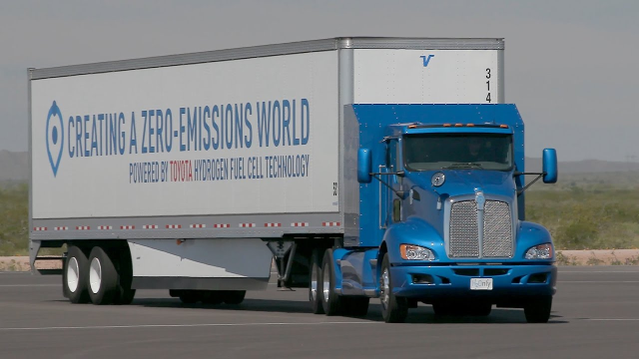

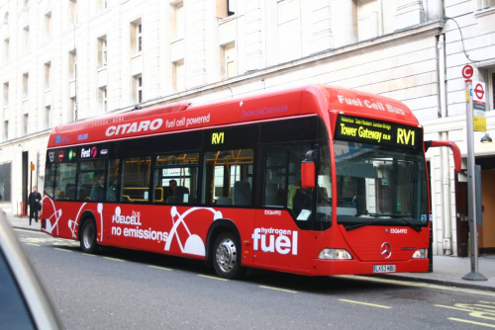
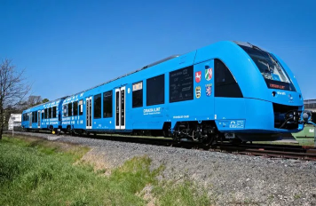
Other markets for fuel cells

Slide 15
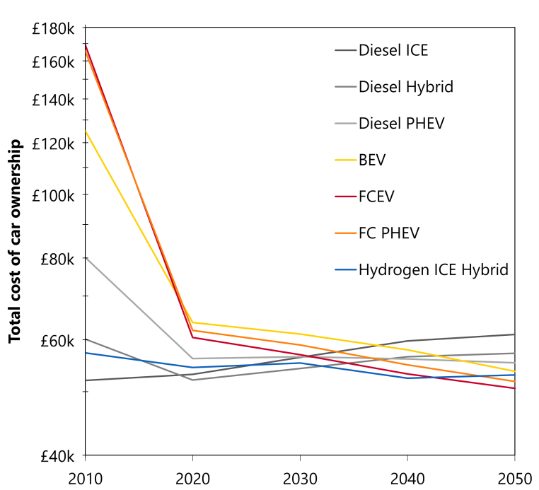
Long-term costs and trade-offs for FCEVs and BEVs
Difficult to predict whether battery electric vehicles or fuel cell vehicles will dominate in the future.
Cost projections are similar.
Battery-only for city cars and hydrogen plug-in hybrids for family cars and long distances?
Battery breakthroughs on the horizon (e.g. Li-air) that could tip the balance?
Super-fast charging?
Quality of the service is important
Dodds PE and Ekins P (2014) A portfolio of powertrains for the UK: An energy systems analysis. IJHE

Slide 16
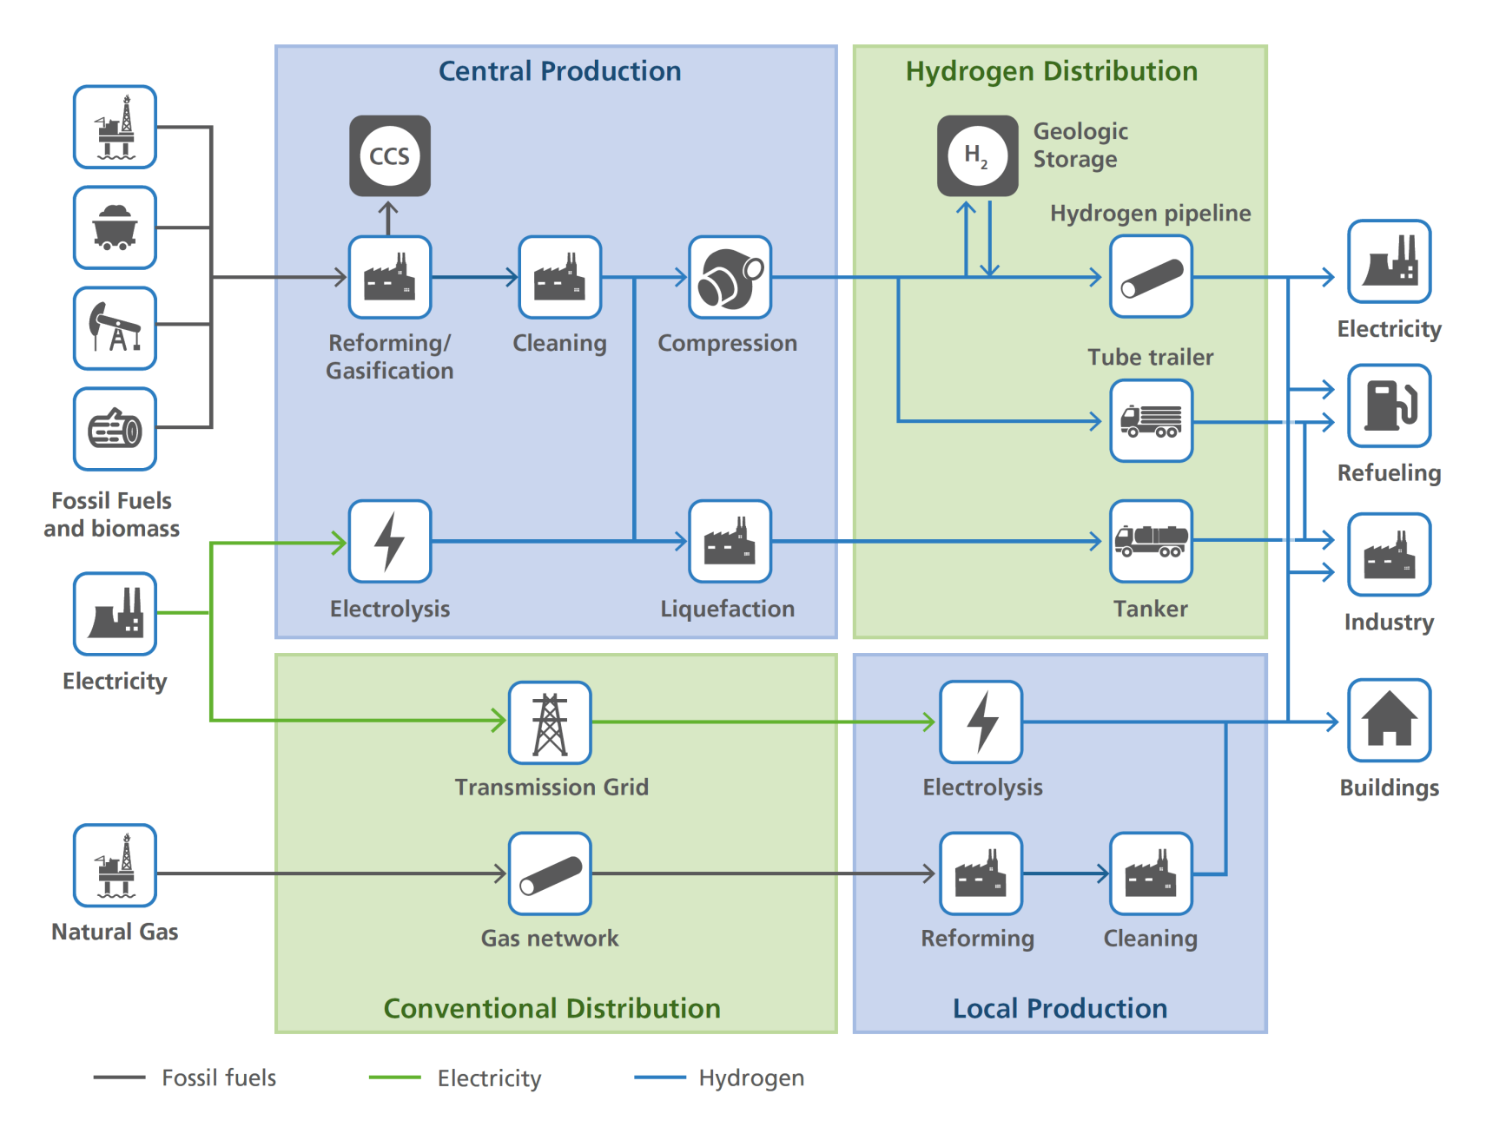
Hydrogen production and delivery infrastructure
Purity and compression needs are often overlooked

Slide 17
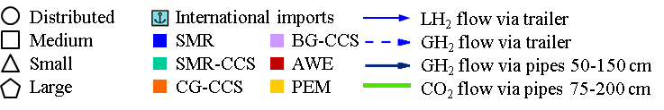
Cost-optimised infrastructure development in a high hydrogen scenario
2020
2030
2040
2050
From the Spatial Hydrogen Infrastructure Planning Model (SHIPMod)

Slide 18
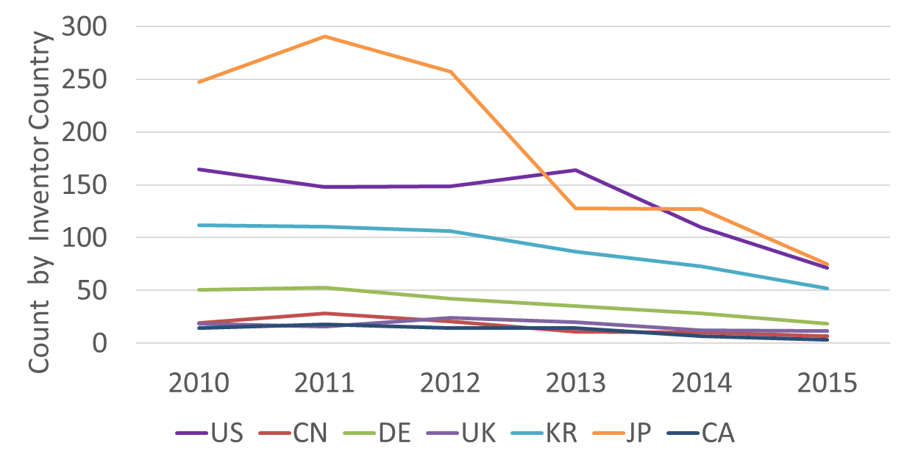
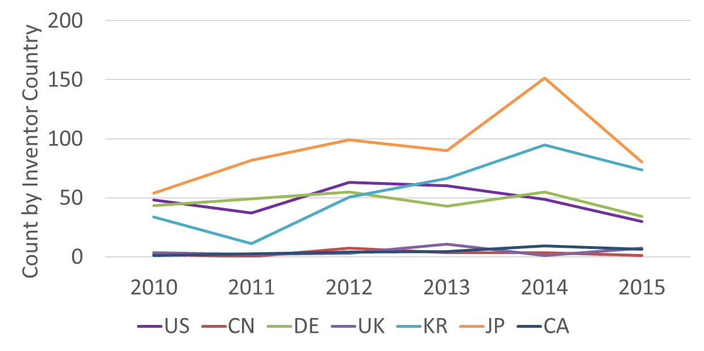
Is the UK at the forefront of hydrogen and fuel cell innovation? Consider patents.
Fuel cells
Global shift from focus on fuel cell design…
Application of hydrogen and fuel cells to transport
…to integration of H2FC into transport and other products
But Japan and the USA, and now Korea, are leaders in patents.

Slide 19
Hydrogen injection can partially decarbonise the gas supply
Partially decarbonise the natural gas supply
Support renewables through “power-to-gas” – at times of high supply and low demand
Current limit of <1% in the UK – from gas regulations set in the 1960s. Varies widely.
Technical limit: 20%v/v?
Economically viable soon
Feasibility | Yes | Probably | Possibly | Difficult
Injection rate (v/v) | 3% | 6% | 10% | 20%
CO₂ reduction | 1% | 2% | 3% | 6%

Slide 20
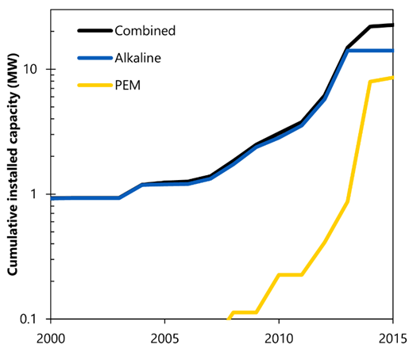
Power-to-gas
Generates hydrogen using excess renewable electricity so power is not wasted.
Economics depend on the cost of the electrolyser and the capacity factor (which reduces as electrolysers are deployed).
If transport and heat were powered mostly by hydrogen, then power-to-gas might supply ~10% of the required hydrogen.
Gas-to-power – hydrogen OCGTs and CCGTs – could be important.

Slide 21
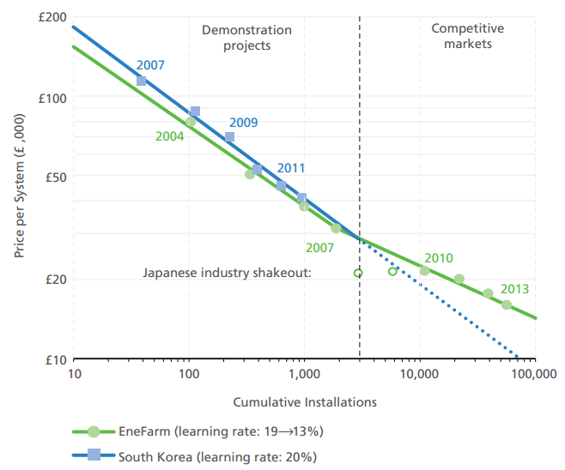
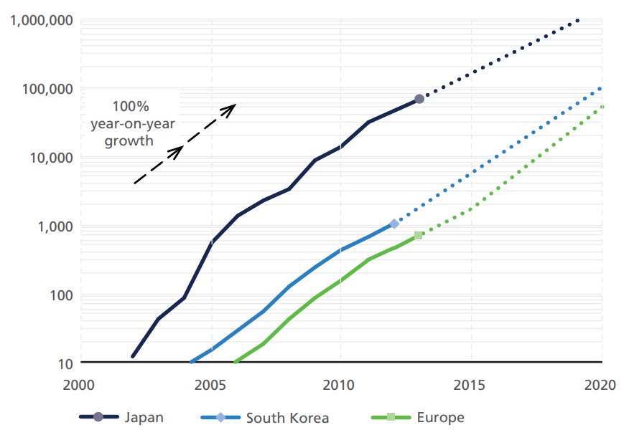
Hydrogen for heating
Heating is by far the largest global market for fuel cells at the moment – supplied with natural gas

Slide 22

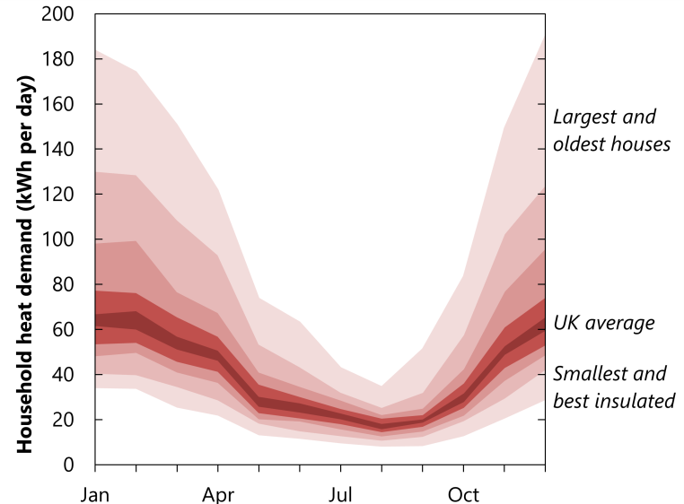
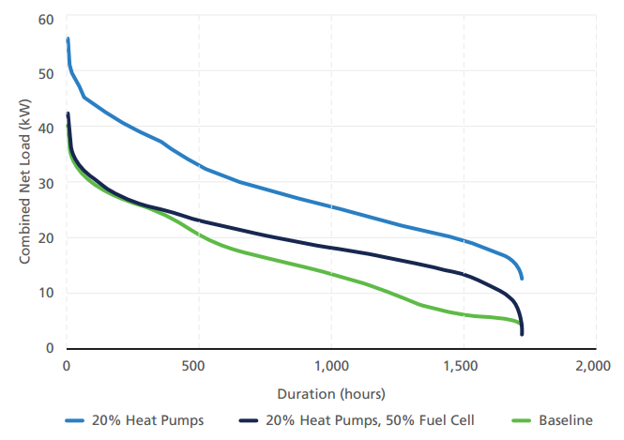
Hydrogen for heating in the UK
Business-as-usual option for homeowners with natural gas heating.
Is it politically feasible to decarbonise heating without decarbonising the gas networks?
Would we use gas boilers, or fuel cell micro-CHP, or hybrid heat pumps?
Quality of service is important
Fuel cell micro-CHP reduces peak heat pump load

Slide 23
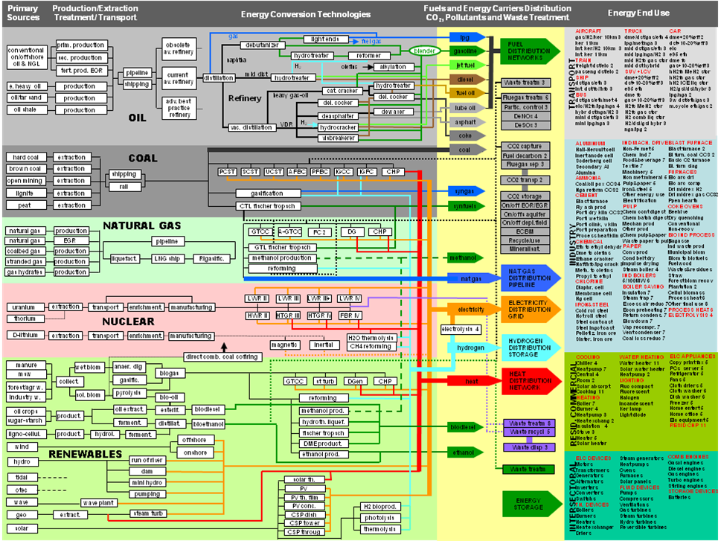

Slide 24
Hydrogen could be the least-cost method for heating…
Conversion of the gas networks
Hydrogen is the least cost option for heating in all scenarios, but is deployed later when made optional rather than mandatory.
 | Optional | Mandated from 2030 to 2050
Optional
Mandated from 2030 to 2050
Gas heating
Note that the Leeds H21 costs are used, but the appliance costs are halved to account for writing off the average value of actual stock. UK TIMES always deploys hydrogen boilers to replace obsolete gas boilers.

Slide 25
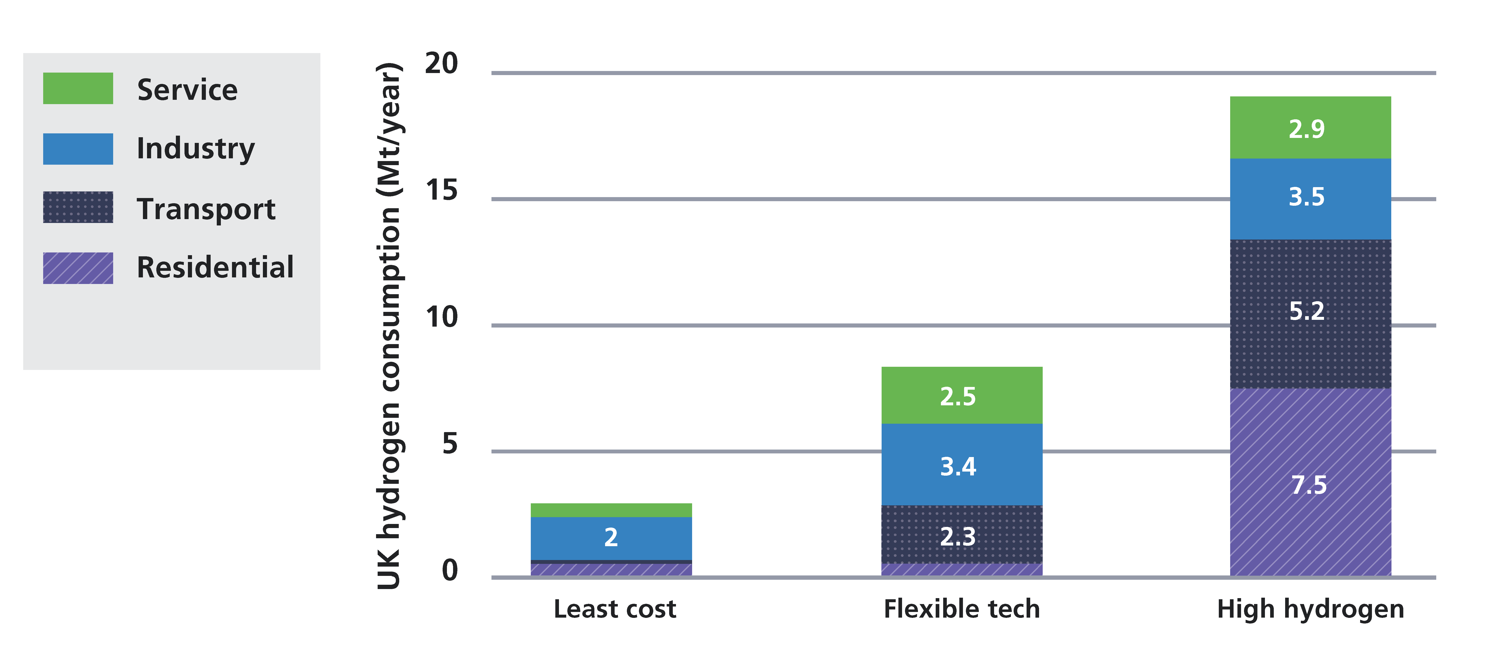
…but it is difficult to make a judgement at the moment
The cheapest option depends on assumptions about the cost of heating technologies and whether steam-methane reforming is viable in a net-zero energy system

Slide 26
Industry
Can high-temperature process heat be decarbonised?
Hydrogen is a potential alternative (e.g. as a reductant in Midrex steel production)
Industry could also provide a high demand at a single location that could enable high-volume, lower-cost hydrogen production?
The UK is looking at using hydrogen in seven large industrial clusters.
This area has huge knowledge gaps.

Slide 27
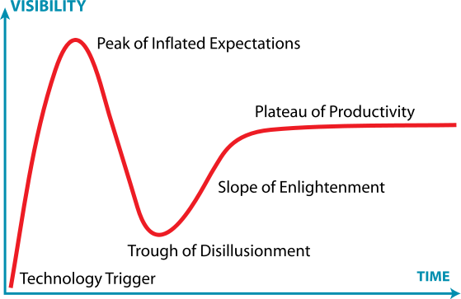
Hydrogen hype cycle
Gartner hype cycle
2002
Late-90s 2020

Slide 28
Challenges for hydrogen and fuel cells
Funding innovation through learning-by-doing to reduce fuel cell vehicle and other technology costs.
Chicken-and-egg infrastructure.
Hydrogen purity and compression requirements for different applications, and how these affect infrastructure development.
Expensive compared to high-carbon alternatives, and also compared to battery electric vehicles in the short-to-medium term.
New demand patterns (e.g. driverless vehicles).

Slide 29
Conclusions
Hydrogen cars are belatedly being commercialised. A range of other hydrogen technologies are also being pursued. There is a lot more realism now than in the past.
Economics, user experience and air pollution will all be key drivers.
The future for hydrogen is difficult to predict, not least because hydrogen and fuel cells could contribute in many diverse ways across many sectors, spanning the energy system.

Slide 30




Thank you for listening
Contact me: p.dodds@ucl.ac.uk

