Slide 1



Geothermal potential mapping of the Sherwood Sandstone in the Humber region
David Peacock, Mark Anderson and Eddie Dempsey, July 2026
Notes:
This presentation gives some results of the mapping done as part of a geothermal assessment project at Hull. Note funding! Also, try to spot the subtle inclusion of three exciting aspects of geology

Slide 2
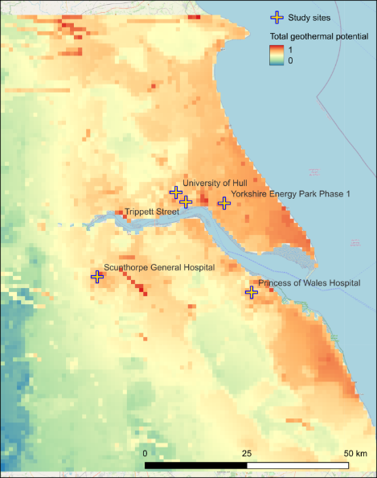
Favourability map
Notes:
This talk is about how we got to this geothermal favourability map for the Sherwood Sandstone of the Humber region. Reds and oranges are most favourable. Considering geological and other factors. Study area is the Humber region, from north of Flamborough Head in the north to Skegness in the south, and to just east of Doncaster in the west

Slide 3
Contents:
Geothermal: what and why
Why the Humber region
The HuGE project
Geology
How to identify the best places
Results
What it means
Conclusions
Notes:
The contents of this presentation

Slide 4
Questions asked
Why does the Humber region need geothermal?
Might geothermal work in the Humber region?
Can we identify the best places for geothermal?
What could geothermal energy achieve?
Notes:
Main conclusions. Note: geology is not the only factor!
The Humber is one of the UK's most challenging regions to decarbonise because of its concentration of energy-intensive industry. Our work suggests that geothermal energy could become one part of the solution, and that favourability mapping provides a practical way of identifying where future investment and detailed investigations should be focused

Slide 5
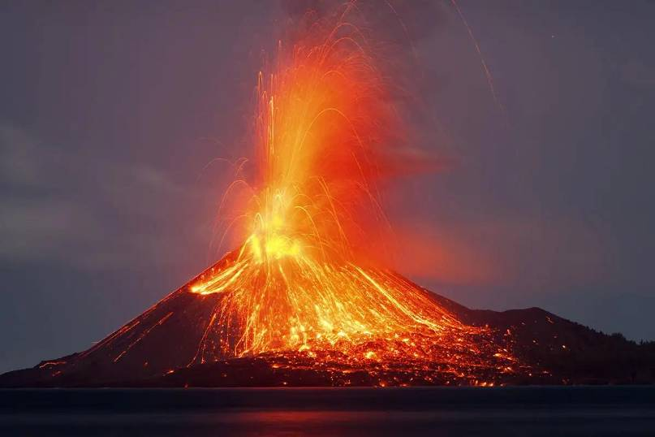
1. Geothermal: what and why
Notes:
Firstly, why use geothermal energy. https://images.newscientist.com/wp-content/uploads/2020/12/21145328/volcanoes-f0r7pt_web.jpg
Volcanoes illustrate the heat that exist in the sub-surface. Geothermal commonly developed in areas of present-day volcanic activity

Slide 6
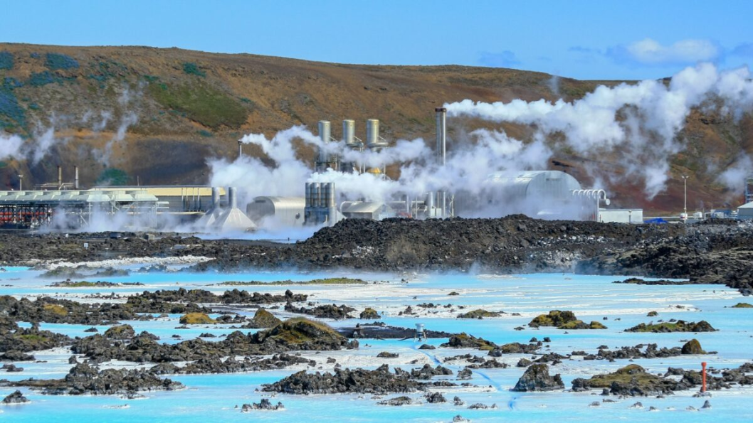
Notes:
Geothermal energy is perhaps most obvious from volcanic regions, like Iceland, where water is hot enough to power turbines that can create electricity. Here, we are interested in the hear rather than electricity
https://emeraldreview.com/2022/10/the-rise-of-geothermal-energy-in-iceland/

Slide 7
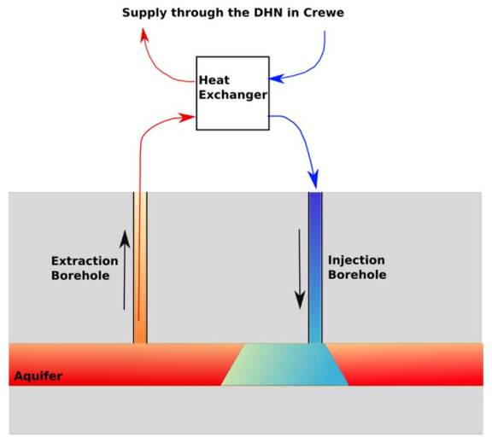
Simple geothermal system
Supply through district heating network
Heat
pump
Notes:
Sketch of a simple system, the sort that would be used in this region. Heat extracted for heating. Too cool for electricity generation and would probably need heat exchangers
https://www.mdpi.com/energies/energies-15-01983/article_deploy/html/images/energies-15-01983-g001.png

Slide 8
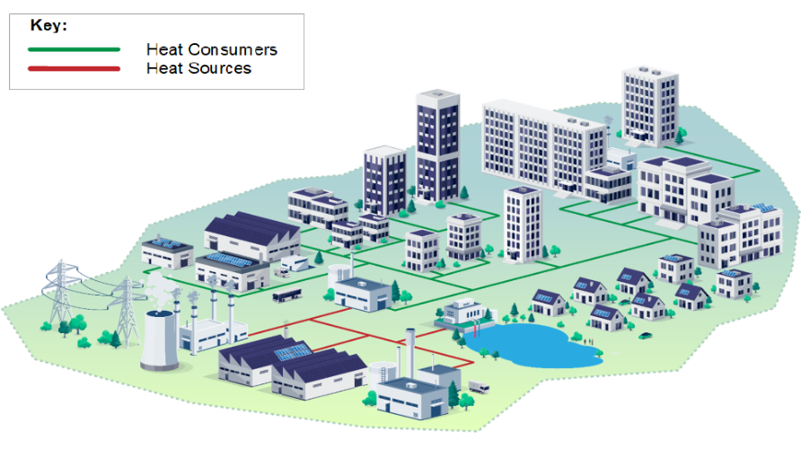
District heat network
Notes:
A district heat network. Heat from a source is supplied to commercial and domestic users.
From: https://www.gov.uk/government/publications/heat-network-zoning-overview/heat-network-zoning-overview

Slide 9
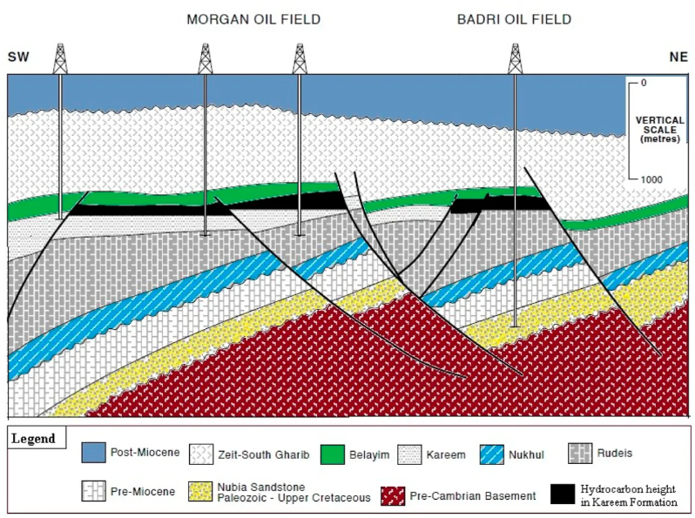
Notes:
Explain cross-section – shows the geology beneath the surface, with distance against depth. Petroleum is non-renewable. It’s gone once extracted. Also, it is a pollutant. Heat is renewable and (mostly) non-pulluting
https://www.frontiersin.org/journals/earth-science/articles/10.3389/feart.2022.967201/full

Slide 10

Notes:
Petroleum is dirty energy, causing visible and invisible pollution. Urgent need to decarbonise
https://external-content.duckduckgo.com/iu/?u=https%3A%2F%2Foceana.org%2Fwp-content%2Fuploads%2Fsites%2F18%2Fshutterstock_1801591879-scaled.jpg&f=1&nofb=1&ipt=b85db28667ddfb1f492aef070ef5d26d3df8bc43814fa3d5a361ad989fa07546

Slide 11
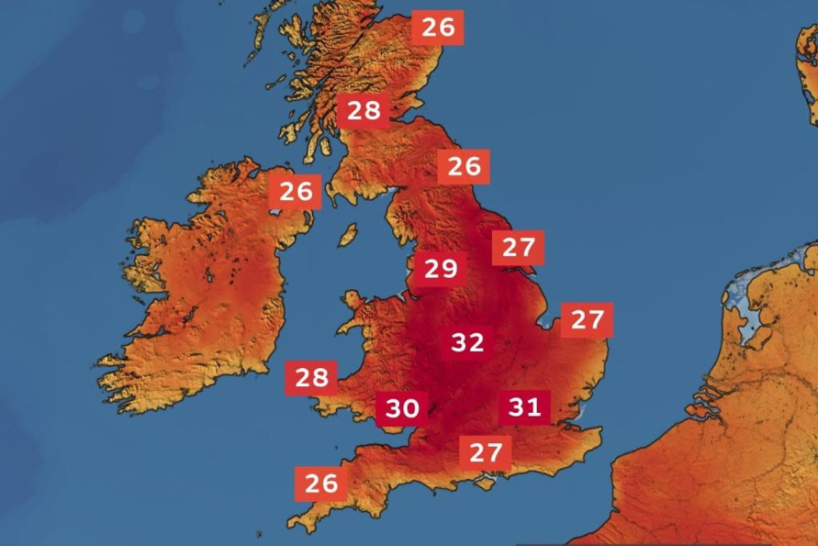
Notes:
The recent UK heatwaves are evidence of the climate crisis and illustrate the need to decarbonise
https://external-content.duckduckgo.com/iu/?u=https%3A%2F%2Fi2-prod.manchestereveningnews.co.uk%2Farticle32024554.ece%2FALTERNATES%2Fs1200f%2F0_heatwave.jpg&f=1&nofb=1&ipt=de20b332f0ad4598902f2fb71f4b612c21134506fd47fdb39f6ca780f8c06156

Slide 12
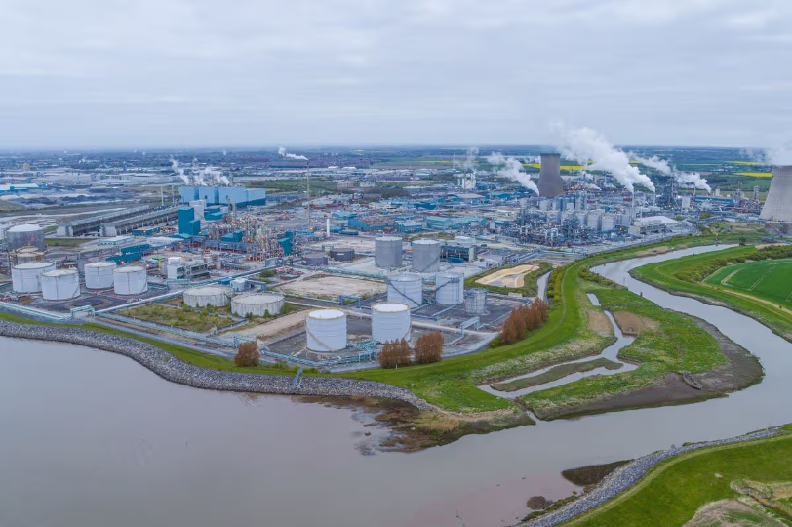
2. Why the Humber region
Notes:
Major industrial centre. Saltend Chemical Park, from https://www.business-live.co.uk/enterprise/humber-industry-urges-government-re-33281536

Slide 13
2. Why the Humber region
The problem: the need to achieve Net Zero, with the Humber region emitting more CO2 than any other UK industrial cluster
The opportunity: deep sedimentary basins beneath East Yorkshire and Northern Lincolnshire contain vast, untapped thermal energy
The advantages of geothermal:
  Baseload: 24/7 energy, unlike intermittent wind/solar
  Local: energy produced and consumed within the region
  Versatile: suitable for industrial processes, hospitals and district heating
Notes:
"Think of the Humber as having a giant, natural 'hot water bottle' buried two kilometres beneath us. My research is about finding exactly where that bottle is thickest and hottest, so our hospitals and factories can plug into it."

Slide 14
3. The HuGE project
Aims to provide information and develop methods that will help people (geoscientists, engineers, decision-makers, politicians and the public) understand issues, risks and opportunities. Work packages:
WP1. Determine and de-risk the geothermal potential
WP2. Viability: work with councils, NHS, Port Authority, etc.
WP3. Engagement: build awareness, stakeholder mapping
Partners: Eden Geothermal and Consortium Drilling
Focus of this presentation
Notes:
The aims of the HuGE project. So far, most emphasis has been on WP1. We certainly need help with WP2 and WP3

Slide 15
Components of the HuGE project discussed here
Qualitative assessment of potential reservoirs
Geothermal favourability mapping
Simple modelling of economic and environmental impact
Notes:
This is what I’ve been working on and what I’m presenting here. The main focus of this talk is the favourability mapping

Slide 16
4. Geology
The heat source: the Earth gets hotter by about 30°C for every kilometre we go down. In the Humber region, if we drill 2 km deep, the water is naturally at ~ 60°C
The reservoir: we look for rocks with open pores (like the Sherwood Sandstone), where the pores are filled with warm water
Permeability: the water has to be able to move. We look for rocks where these holes are connected so we can pump the water up to the surface
Extracting heat: we bring the hot water up, extract the heat using a heat exchanger or heat pump, and then reinject the cooled water back down to be reheated by the Earth. It’s a circular loop
Notes:
To understand why the Humber is special, we have to look at what’s under our feet. Most people think of rock as a solid, impenetrable block. But geologists see the Sherwood Sandstone beneath East Yorkshire as a giant, prehistoric sponge.
The Earth is a massive radiator. Because the Humber sits on a deep 'sedimentary basin'—think of it as a deep bowl filled with layers of these sponges—we can tap into water that has been trapped there for millions of years, naturally heated by the Earth's core. We don't 'consume' the water; we just 'borrow' its heat, circulate it through our hospitals or factories, and put the water back down to get warm again. No carbon, no waste, just a constant loop of energy."
The "Jargon Translator"
To help the non-geologists feel included, you could include a tiny "cheat sheet" at the bottom of the slide:
Aquifer: A rock layer that holds water.
Geothermal Gradient: How much hotter it gets the deeper you dig.
Pore Space: The tiny gaps between grains of sand where the hot water lives.

Slide 17
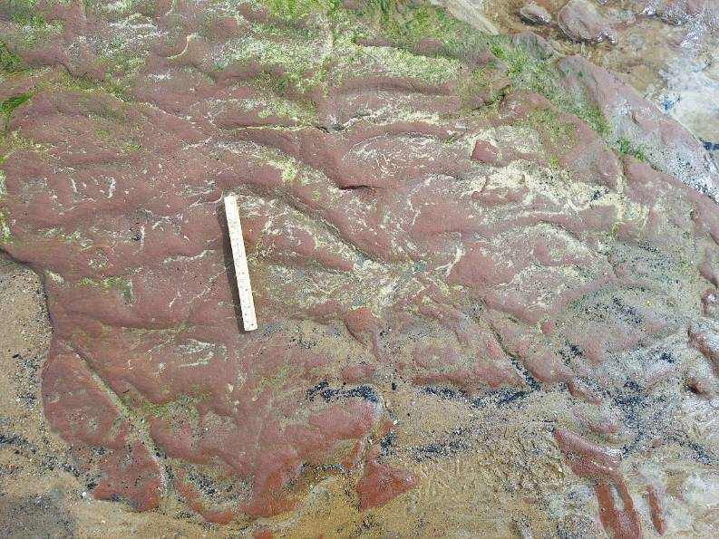
Notes:
Sherwood Sandstone poorly-exposed in the region. This is the Sherwood Sandstone at Seaton Carew, on the coast north of the study area. Ripple marks on sandstone bed

Slide 18

Notes:
Deposited at the start of the dinosaur era. https://interestingengineering.com/science/dinosaur-ancestor-migration-triassic

Slide 19
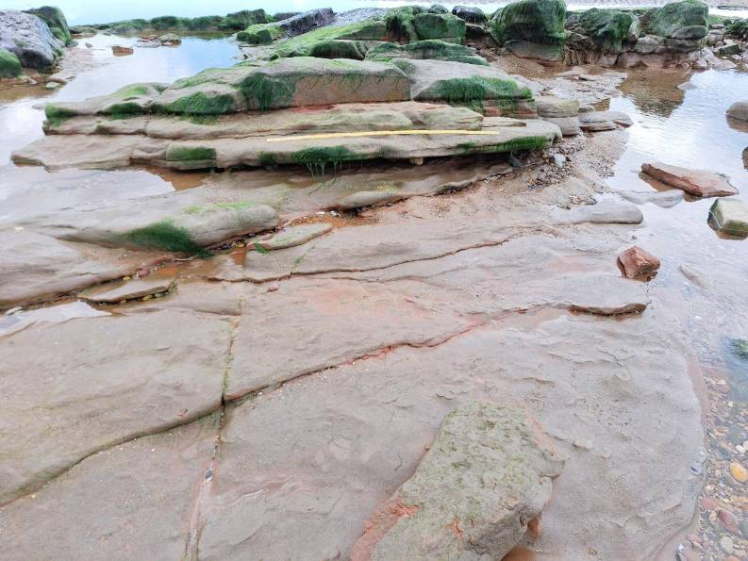
Notes:
Sandstone beds at Seaton Carew. Relatively soft related to high porosity

Slide 20
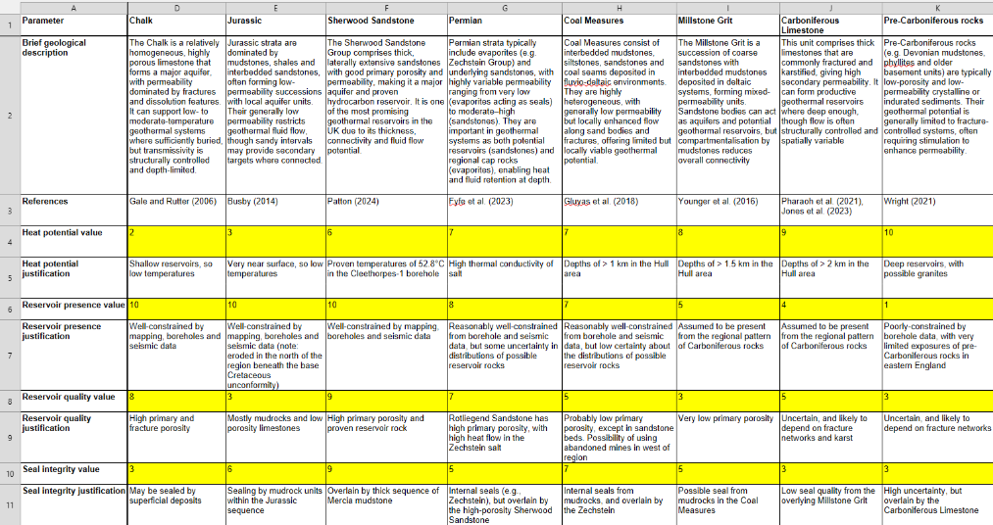
Why the Sherwood Sandstone
Notes:
We did a qualitative assessment of the potential reservoir rocks in the region and produced a table

Slide 21
Why the Sherwood Sandstone
The Sherwood Sandstone is ranked highest because:
Usable temperature
Good reservoir quality with a good seal above
Simple to drill
Low environmental impact
Good quality data and high certainty
Low risk
Potential unit | Overall favourability
Superficial deposits | 65
Chalk | 73
Jurassic | 64
Sherwood Sandstone | 81
Permian | 59
Coal Measures | 55
Millstone Grit | 47
Carboniferous Limestone | 47
Pre-Carboniferous rocks | 38
Notes:
We did a qualitative assessment of the potential reservoir rocks in the region and produced a table

Slide 22
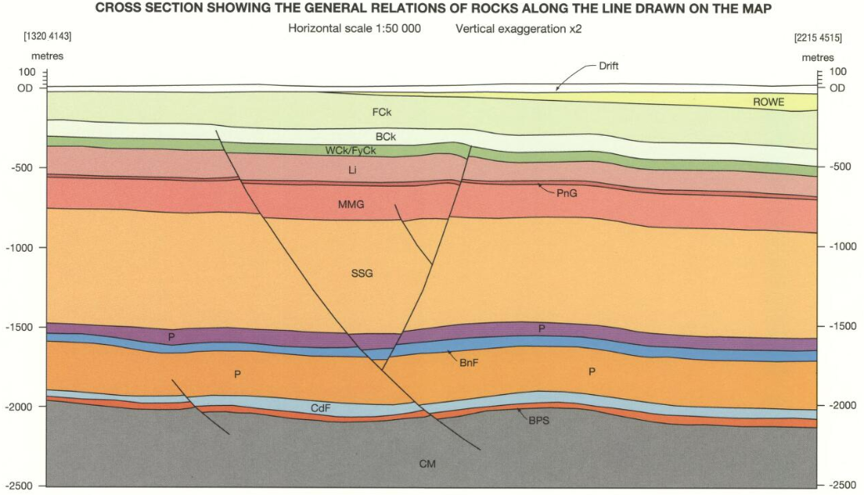
Scunthorpe
General
Hospital
Uncertainty
increases
with depth
Notes:
Explain what a cross-section is! Geothermal is renewable. From the BGS Hornsea sheet. Note apparent structural simplicity.
Several potential reservoirs exist
Drift for shallow
Chalk for heat storage?
Jurassic, Triassic and Permian for deep. Could even include Carboniferous
Possibly Coal Measures
The focus of HuGE is the Sherwood Sandstone, but integration and diversity may be important.
White Paper refers to “deep” geothermal as being at depths of more than 500m
High certainty for shallow, good for medium-deep, low certainty for deep
Geothermal project in Scunthorpe targets the Sherwood Sandstone

Slide 23
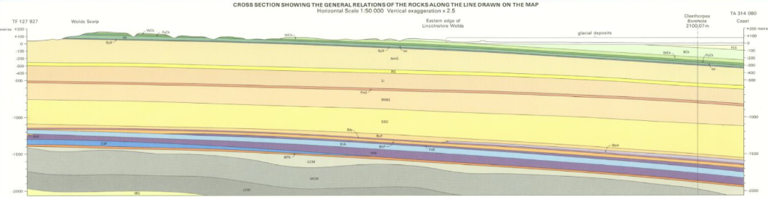
Cleethorpes-1 well
~ 50°C
1000-1500 m depth
Flow ~ 20 l/sec
Sherwood Sandstone
Salt
Notes:
Another cross-section. Geothermal well at Cleethorpes suggests usable temperatures and flow rates.

Slide 24
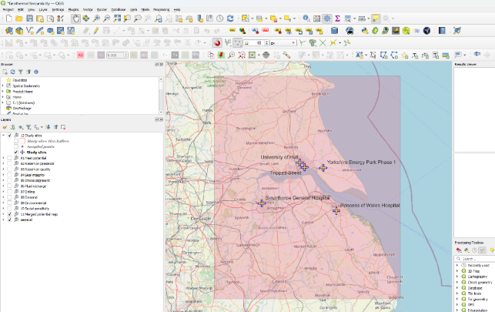
5. How to identify the best places
Data: public-domain (guided by AI)
Analysis and presentation: geospatial analysis (QGIS) of the region
Output: favourability assessment of the region and of specific sites
Notes:
The approach used. Note the use of QGIS

Slide 25
Why Geographic Information System
Integrates diverse datasets (geological, geophysical, environmental, infrastructure and socio-economic)
Transparent and reproducible (steps, assumptions and weightings are explicit and can be reviewed or modified)
Flexible multi-criteria analysis (different factors can be weighted and combined to explore alternative scenarios)
Visualisation (produces clear maps that communicate complex information to technical and non-technical audiences)
Easy to update (new datasets or revised interpretations can be incorporated)
QGIS is open-source (free and with extensive community support)
Notes:
QGIS has many advantages

Slide 26
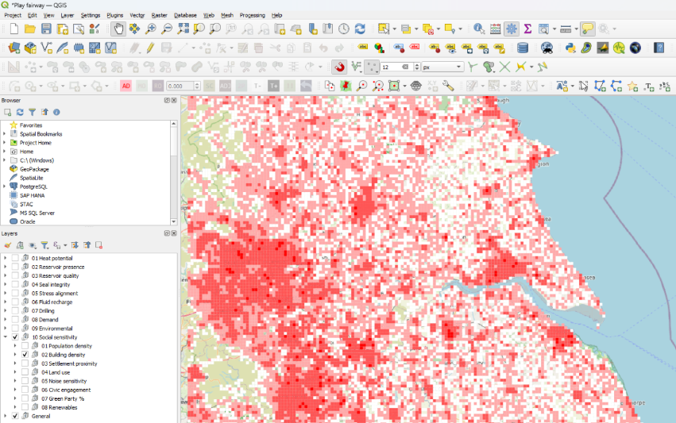
Geothermal favourability mapping
10 data classes
Hull
Notes:
Making systematic favourability maps using public domain data. Notice the categories in the left window, which includes surface parameters. It’s not just about the geology! No single factor determines whether geothermal is viable. We therefore combined ten different datasets—covering geology, engineering, heat demand and environmental constraints—to identify where the overall conditions are most favourable. I have used ChatGPT heavily to get appropriate public-domain data, and develop a rigorous scheme for the analysis. Different categories are weighted, with the weightings being open for discussion. Demand (Hull) and reservoir temperature (Grimsby), but it is hoped that the approach used will be of interest to stakeholders and will be transferable

Slide 27
Steps
Find and import data (using correct coordinate reference system)
Where necessary, interpolate data
Find value for each 1 km² grid square
Clip to the region of interest
Normalise the data, such that 1 = most favourable, 0 = least favourable
Create a geoTIFF
Merge the geoTIFFs using an appropriate weightings
Normalise the merge, such that 1 = most favourable, 0 = least favourable
Note that 0 does not mean no potential and 1 does not necessarily mean an area is perfect
Notes:
Don’t explain this in great detail. Say that I followed a set procedure. Note the normalisation: (1) different data types can be compared. (2)) zero does not mean no potential and 1 does not mean ideal. Relative favourability.

Slide 28
6. Results
Favourability maps
Assessment of certainty
Site specific analyses
Notes:
The results are favourability maps, assessment of certainty and inputs into site-specific analyses. Economics and CO2 savings discussed later

Slide 29
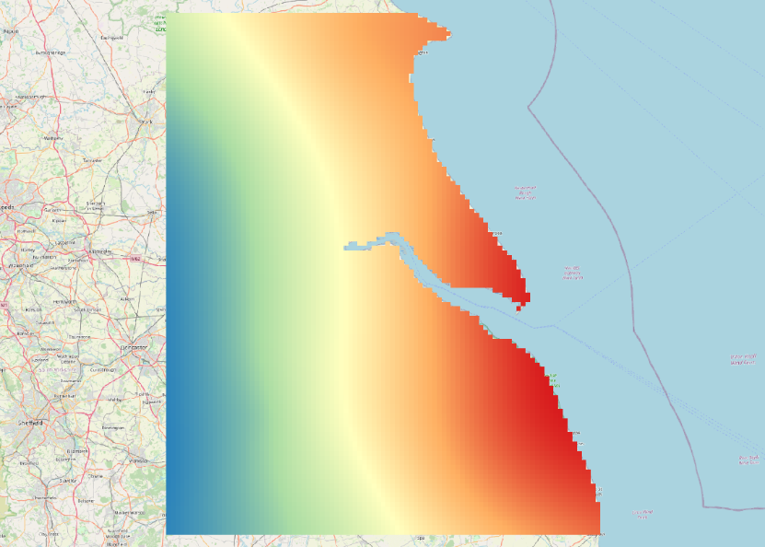
Heat potential
Hull
Notes:
Some examples of the normalised mapsHeat potential map, from BGS

Slide 30
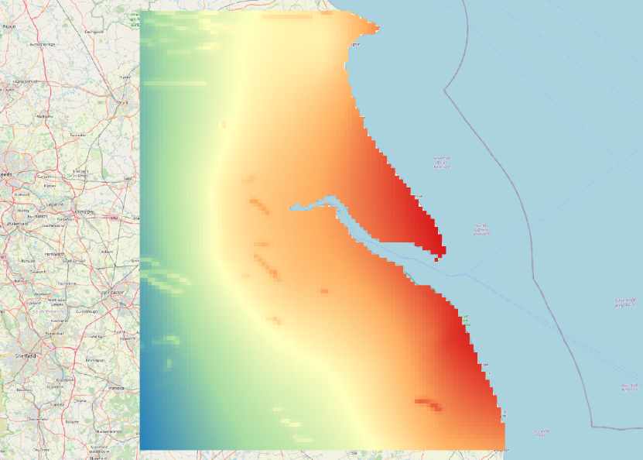
Geological favourability
Notes:
Merged geological favourability map, with heat potential heavily rated. Highest rating along the coast where the Sherwood Sandstone is deepest and hottest

Slide 31
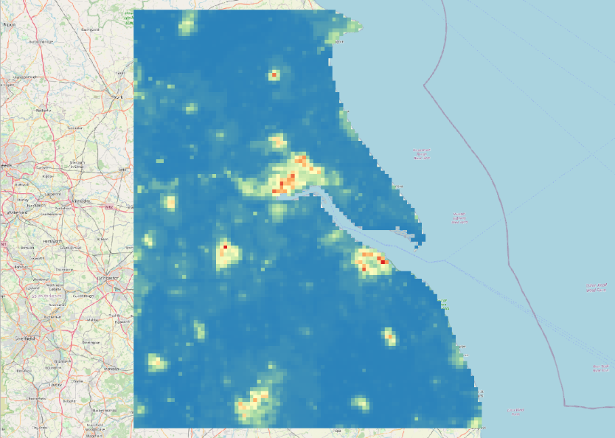
Demand
Driffield
Hull
Scunthorpe
Grimsby
Lincoln
Notes:
Merged data for demand. Obviously, main population centres are picked out

Slide 32
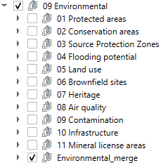
Environmental
Layer | Weight | Rationale
Protected areas | 0.2 | AONBs, SSSIs, etc.
Conservation areas | 0.2 | Prioritises lower-quality land (Grade 3b–5) over “Best and Most Versatile” land.
SPZ (Source Protection Zones) | 0.2 | Protects potable groundwater; higher scores for areas outside zones 1 and 2.
Brownfield sites | 0.2 | Regarded as favourable for redevelopment.
Heritage | 0.2 | Constraints such as Scheduled Monuments.
Notes:
Environmental parameters as an example of how the final favourability map depends on the weightings used and hos they are added

Slide 33
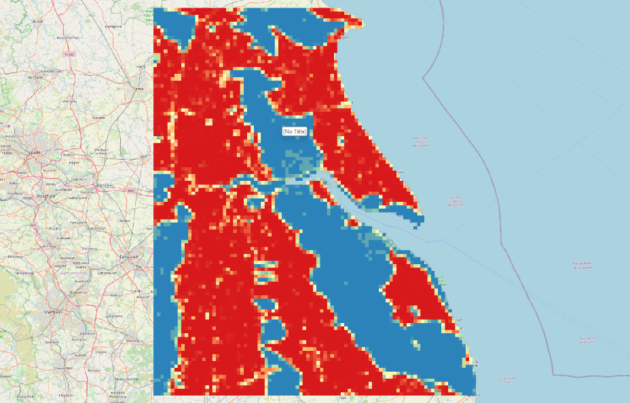
Environmental
(multiplied)
Notes:
Environmental factors multiplied, tending to create “no-go” areas because of environmental constraints

Slide 34
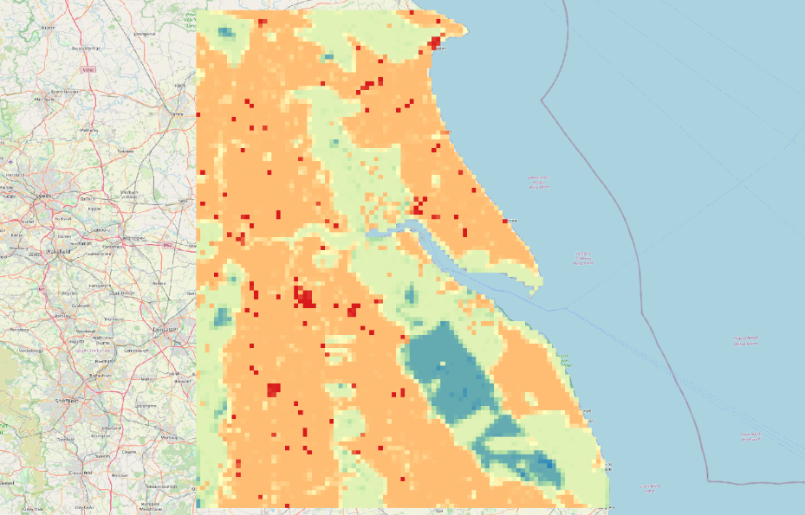
Environmental
(additive)
Notes:
Environmental factors added, tending not to create “no-go” areas because of environmental constraints. Hot-spots. Which is better? I’m not sure, but a big part of this work is to open discussions

Slide 35
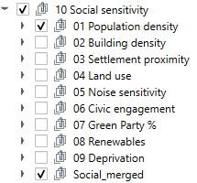
Social sensitivity
Criterion | Suggested weight | Rationale for weighting
Noise sensitivity | High (e.g. 35%) | Geothermal drilling is a high-intensity industrial activity. Proximity to noise-sensitive receptors (hospitals, schools, residential areas) is the most frequent cause of local planning opposition. High weighting ensures the model prioritises sites that minimise sleep disturbance and local nuisance.
Index of Multiple Deprivation (IMD) | Medium-High (e.g. 25%) | Aligned with “Just Transition” principles, geothermal projects should be steered toward areas of higher deprivation. These areas stand to benefit most from fuel poverty reduction, local job creation and district heating subsidies. Weighting this highly ensures social equity is a driver of the site selection.
Population density | Medium (e.g. 25%) | While high density provides a ready market for heat (demand), it also increases the total number of people exposed to construction risks and traffic. A moderate weight balances the technical "need" for customers with the social “risk” of large-scale disruption in urban centres.
Green Party vote | Low (e.g. 15%) | Political affiliation is used as a proxy for “ideological readiness”. While high Green support suggest a predisposition toward renewable energy, it is considered a secondary factor compared to tangible physical impacts like noise or economic necessity.
Notes:
Example of social sensitivity data and how they are merged

Slide 36
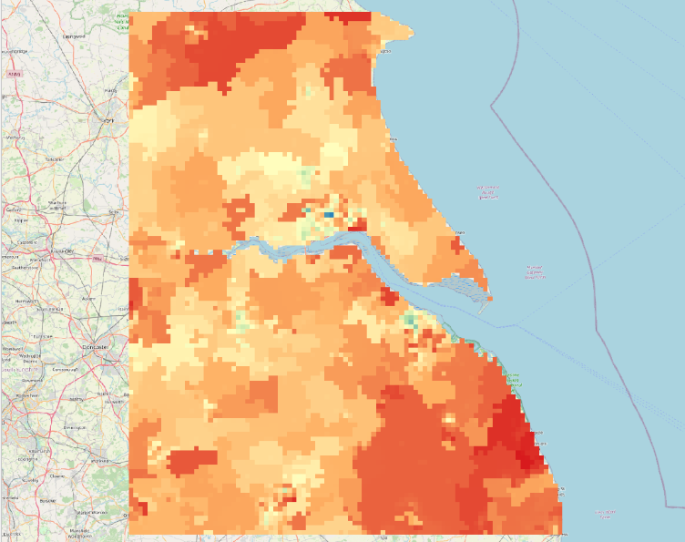
Social sensitivity
University
Notes:
Social sensitivity geoTIFF. The University area scores relatively low because it is not considered a socially-deprived area

Slide 37
Weightings used
Pillar | Class | Suggested weight | Rationale
Resource (40%) | Heat potential | 20% | The primary driver. High heat = high power/heat output
 | Reservoir presence | 10% | Basic geological requirement; is there actually a host rock
 | Reservoir quality | 10% | Porosity/Permeability. Crucial for flow rates and commerciality
Geomechanical (20%) | Seal integrity | 5% | Prevents heat loss and protects shallower aquifers
 | Stress alignment | 10% | Critical for "Ease of Flow." If stress shuts fractures, the well fails
 | Fluid recharge | 5% | Ensures long-term sustainability of the heat resource
Economic (20%) | Drilling feasibility | 10% | Depth/rig accessibility. A 5km well is exponentially costlier than 2km
 | Heat demand | 10% | Distance to customers. Lowers pipe costs and heat loss
Constraints (20%) | Environmental | 10% | Statutory protected zones (SSSI, protected habitat, etc.)
 | Social sensitivity | 10% | Factors influencing social acceptance (noise, voting, IMD, population density)
Notes:
Weightings used, as suggested by Google Gemini. Also asked ChatGPT, which gave similar suggestions

Slide 38
Favourability map
Notes:
Favourability map for the Sherwood Sandstone using the weightings suggested by Google Gemini. Blues and greens = lowest favourability, oranges and reds = highest. Highest ratings around the Humber Estuary and around Grimsby, where the Sherwood Sandstone is deepest and therefore warmest, and there is demand.

Slide 39
Certainty matrix
Data class | Data quality (1–5) | Interpretation certainty (1–5) | Rationale
1. Heat potential | 2 | 4 | Sparse borehole data (low density), but thermal gradients follow predictable physical laws.
2. Reservoir presence | 2 | 4 | Deep seismic/well logs are limited, but stratigraphic continuity is geologically reliable.
3. Reservoir quality | 1 | 3 | Porosity/permeability varies wildly even over metres; high risk of local "dry" spots.
4. Seal integrity | 2 | 4 | Based on known regional caprocks; usually consistent over large areas.
5. Stress alignment | 2 | 3 | Derived from regional tectonic models; local fracture behaviour can be unpredictable.
6. Fluid recharge | 2 | 2 | Highly complex hydrogeology; hard to model long-term sustainability without flow tests.
7. Drilling feasibility | 4 | 5 | Excellent BGS/topographic data on depth, slope and surface access.
8. Heat demand | 5 | 4 | High-resolution census/building data, though future demand (20+ years) is an estimate.
9. Environmental issues | 5 | 5 | Statutory designations (SSSIs, parks) are binary and legally definitive.
10. Social sensitivity | 5 | 2 | Exhaustive census/election data, but "political vote" is a weak proxy for project support.
Notes:
Certainty in the data and interpretations. Qualitative! Helps identify uncertainties and need for better data.

Slide 40

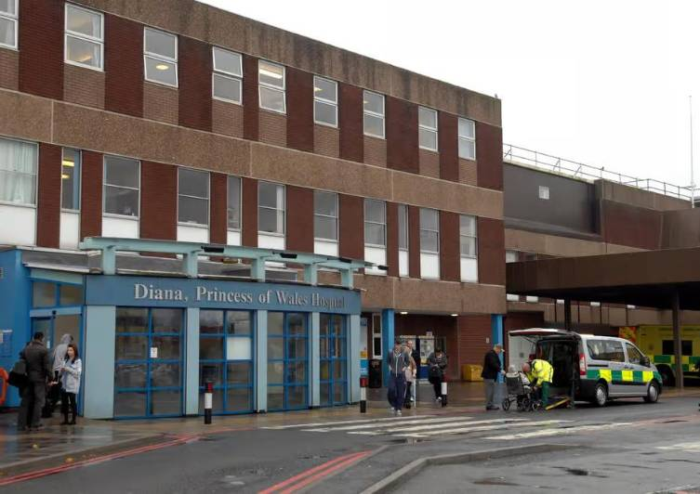
Site evaluation
Notes:
The parameters from the favourability maps can be used for site-specific evaluation. The most likely sites will be the University of Hull and Princess of Wales Hospital, Grimsby.

Slide 41
Site evaluation
Several sites have been selected for evaluation
Values collected from the QGIS project, including the favourability maps
This information enables the selected sites to be ranked
Some data can also be used to calculate potential heat production, financial value of that heat and amount of CO2 saved
Notes:
Outline of the site evaluation

Slide 42
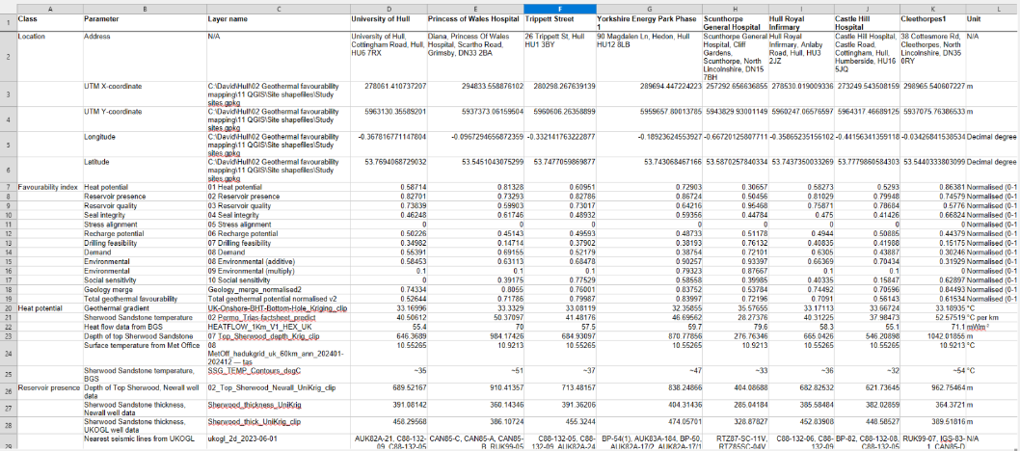
Site evaluation
Notes:
Part of the spreadsheet showing data for the selected sites extracted from the favourability maps.

Slide 43
Ranking of the selected sites
Site | Total normalised geothermal potential
University of Hull | 0.52644
Princess of Wales Hospital | 0.71786
Trippett Street | 0.79987
Yorkshire Energy Park Phase 1 | 0.83997
Scunthorpe General Hospital | 0.72196
Hull Royal Infirmary | 0.7091
Castle Hill Hospital | 0.56143
Cleethorpes1 | 0.61534
Notes:
Results of overall favourability.

Slide 44
7. What it means
The Sherwood Sandstone has good potential and very well-constrained geology
Temperature increases with depth, but so does uncertainty, with deeper rocks being more problematic
High potential areas include Hull, Grimsby, Hornchurch, Maplethorpe
Weighting will influence favourability, but rock temperature and demand are always likely to be key factors
The fluid recharge model should be improved and social sensitivity should be addressed further
But what about the value?
Notes:
Some thoughts on what this means. But what about the heat, value and CO2?

Slide 45
Heat extraction estimates
Site name | University of Hull | Princess of Wales Hospital | Trippett Street | Hull Royal Infirmary | Saltend Chemicals Park | Associated British Ports | Leverton Farms
x coordinate | 507676 | 526209 | 510084 | 508346 | 516454 | 520197 | 495579
y coordinate | 431574 | 407067 | 429214 | 428732 | 427732 | 415147 | 374882
Longitude | -0.3678 | -0.0967 | -0.3321 | -0.3586 | -0.2361 | -0.1843 | -0.5686
Latitude | 53.7694 | 53.5451 | 53.7477 | 53.7437 | 53.7330 | 53.6191 | 53.2623
15 L/s 20°C reinject (kW) | 1286 | 1904 | 1347 | 1274 | 1561 | 1701 | 598
15 L/s 15°C reinject (kW) | 1599 | 2218 | 1660 | 1587 | 1874 | 2015 | 912
15 L/s 10°C reinject (kW) | 1913 | 2531 | 1974 | 1901 | 2188 | 2328 | 1225
20 L/s 20°C reinject (kW) | 1714 | 2539 | 1796 | 1698 | 2081 | 2268 | 797
20 L/s 15°C reinject (kW) | 2132 | 2957 | 2214 | 2116 | 2499 | 2686 | 1215
20 L/s 10°C reinject (kW) | 2550 | 3375 | 2632 | 2534 | 2917 | 3104 | 1633
30 L/s 20°C reinject (kW) | 2571 | 3809 | 2694 | 2547 | 3122 | 3402 | 1196
30 L/s 15°C reinject (kW) | 3198 | 4436 | 3321 | 3174 | 3749 | 4029 | 1823
30 L/s 10°C reinject (kW) | 3825 | 5063 | 3948 | 3801 | 4376 | 4656 | 2450
60 L/s 20°C reinject (kW) | 5143 | 7617 | 5388 | 5094 | 6244 | 6804 | 2392
60 L/s 15°C reinject (kW) | 6397 | 8871 | 6642 | 6348 | 7498 | 8058 | 3646
60 L/s 10°C reinject (kW) | 7651 | 10125 | 7896 | 7602 | 8752 | 9312 | 4900
Notes:
Estimates of heat production from the selected sites, making simple assumptions and different reinjection temperatures. I can share the calculations with anyone who’s interested, but it’s very simple.

Slide 46
Estimates of values of gas savings
Site name | University of Hull | Princess of Wales Hospital | Trippett Street | Hull Royal Infirmary | Saltend Chemicals Park | Associated British Ports | Leverton Farms
15 L/s 20°C reinject (£/year) | 732097 | 1084286 | 766929 | 725175 | 888809 | 968577 | 340513
15 L/s 15°C reinject (£/year) | 910604 | 1262793 | 945435 | 903682 | 1067316 | 1147083 | 519019
15 L/s 10°C reinject (£/year) | 1089111 | 1441299 | 1123942 | 1082189 | 1245823 | 1325590 | 697526
20 L/s 20°C reinject (£/year) | 976129 | 1445714 | 1022571 | 966901 | 1185078 | 1291435 | 454017
20 L/s 15°C reinject (£/year) | 1214138 | 1683723 | 1260581 | 1204910 | 1423088 | 1529445 | 692026
20 L/s 10°C reinject (£/year) | 1452147 | 1921733 | 1498590 | 1442919 | 1661097 | 1767454 | 930035
30 L/s 20°C reinject (£/year) | 1464193 | 2168571 | 1533857 | 1450351 | 1777618 | 1937153 | 681025
30 L/s 15°C reinject (£/year) | 1821207 | 2525585 | 1890871 | 1807365 | 2134632 | 2294167 | 1038039
30 L/s 10°C reinject (£/year) | 2178221 | 2882599 | 2247885 | 2164379 | 2491645 | 2651181 | 1395053
60 L/s 20°C reinject (£/year) | 2928387 | 4337142 | 3067714 | 2900702 | 3555235 | 3874306 | 1362050
60 L/s 15°C reinject (£/year) | 3642415 | 5051170 | 3781742 | 3614729 | 4269263 | 4588334 | 2076078
60 L/s 10°C reinject (£/year) | 4356442 | 5765198 | 4495769 | 4328757 | 4983291 | 5302361 | 2790106
Notes:
Estimates of value of gas saved. Note, however, that the value of electricity needed to run the heat pumps mean that actual savings will be marginal or non-existent! Advantages, however, include security from increases in electricity and gas prices, especially if the heat pumps are run using solar and/or wind turbines. Integration is key

Slide 47
Estimates of CO2 savings
Site name | University of Hull | Princess of Wales Hospital | Trippett Street | Hull Royal Infirmary | Saltend Chemicals Park | Associated British Ports | Leverton Farms
15 L/s 20°C reinject (t CO2/year) | 2072 | 3069 | 2171 | 2053 | 2516 | 2742 | 964
15 L/s 15°C reinject (t CO2/year) | 2578 | 3575 | 2676 | 2558 | 3021 | 3247 | 1469
15 L/s 10°C reinject (t CO2/year) | 3083 | 4080 | 3182 | 3063 | 3527 | 3752 | 1975
20 L/s 20°C reinject (t CO2/year) | 2763 | 4092 | 2895 | 2737 | 3355 | 3656 | 1285
20 L/s 15°C reinject (t CO2/year) | 3437 | 4766 | 3568 | 3411 | 4028 | 4330 | 1959
20 L/s 10°C reinject (t CO2/year) | 4111 | 5440 | 4242 | 4085 | 4702 | 5003 | 2633
30 L/s 20°C reinject (t CO2/year) | 4145 | 6139 | 4342 | 4106 | 5032 | 5484 | 1928
30 L/s 15°C reinject (t CO2/year) | 5155 | 7149 | 5353 | 5116 | 6043 | 6494 | 2938
30 L/s 10°C reinject (t CO2/year) | 6166 | 8160 | 6363 | 6127 | 7053 | 7505 | 3949
60 L/s 20°C reinject (t CO2/year) | 8290 | 12277 | 8684 | 8211 | 10064 | 10967 | 3856
60 L/s 15°C reinject (t CO2/year) | 10311 | 14299 | 10705 | 10232 | 12085 | 12989 | 5877
60 L/s 10°C reinject (t CO2/year) | 12332 | 16320 | 12726 | 12254 | 14107 | 15010 | 7898
Notes:
Estimates of corresponding reduction of CO2. This is very simple modelling and should be done in more detain by an expert in engineering and economics rather than by a geologist

Slide 48
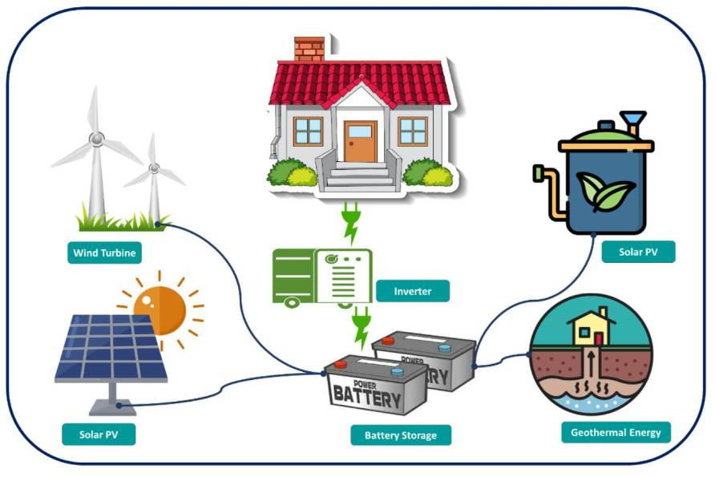
Notes:
A key factor is likely to be integrated renewable energy, especially wind and solar to power heat pumps
https://encyclopedia.pub/media/item_content/202401/65adca66dac4fsustainability-16-00638-g010.png

Slide 49
Keys to success:
Geology (temperature, flow rate)
Demand
Economics (drilling, plumbing, maintenance)
Integrated renewable energy system
Political will and support
Network of enthusiastic people
Notes:
Key factors, probably of increasing importance

Slide 50
8. Conclusions
Why does the Humber region need geothermal?
High demand and urgent need to decarbonise
Might geothermal work in the Humber region?
The region has great geothermal potential
Can we identify the best places for geothermal?
The Sherwood Sandstone is the most promising reservoir. The best places are where it is deepest and warmest and where there is demand
What could geothermal energy achieve?
It can play an important role in heating and regional decarbonisation
For more information: davidcppeacock@gmail.com
Notes:
Main conclusions. Note: geology is not the only factor!
The Humber is one of the UK's most challenging regions to decarbonise because of its concentration of energy-intensive industry. Our work suggests that geothermal energy could become one part of the solution, and that favourability mapping provides a practical way of identifying where future investment and detailed investigations should be focused
Please email if you would lime more information

Slide 51
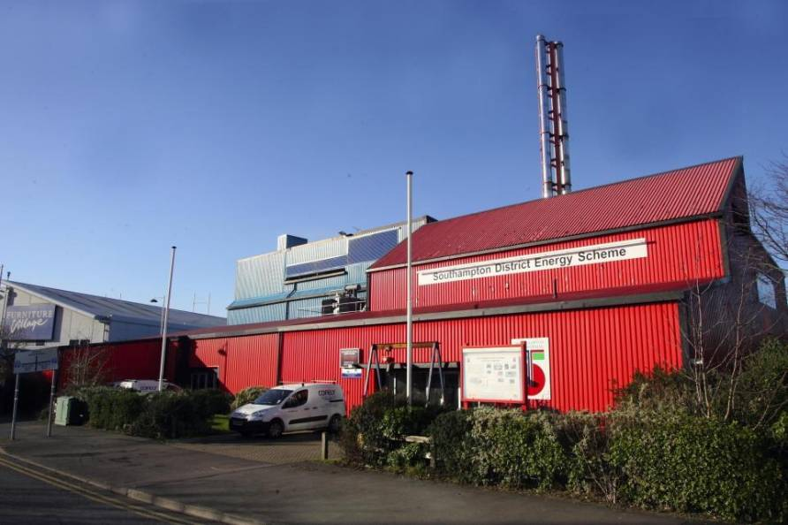
Notes:
Example of where this has worked in the Sherwood Sandstone: Southampton. Note the low visual impact. Shows this can be done

Slide 52

Notes:
https://www.foxnews.com/entertainment/dwayne-johnson-meets-michigan-boy-who-used-san-andreas-cpr-tips-to-save-drowning-brother
Something else geologically more exciting. Note that we would not need to do fracking! I was interested to learn, however, that opposition to fracking with respect to geothermal energy has decreased

